Slide 1
CS 235100 Data Structures 資料結構
Trees – Part III
Department of Computer Science
National Tsing Hua University

Slide 2
Binary Search Tree
All BST operations are O(h)
h = height of BST
Worst case h=n
Insert keys 1, 2, … n
Best case h=logn
Insert keys : 4, 2, 6, 1, 3, 5, 7
1
4
2
2
6
3
1
3
5
7
n

Slide 3
Binary Search Tree: Worst Case
The problem is caused by the lack of tree balance.
Compare depths of left & right subtrees
The worst case generates an unbalanced degenerate tree
Linked list

Slide 4
Binary Search Tree: Best Case
Ensure a complete tree after every operation
It is expensive
Insert 3 in the tree on the left and then rebuild as a complete tree
5
4
Insert 3
2
6
2
7
Complete tree
1
4
6
1
3
5
7

Slide 5
How to Keep a Balanced BST ?
AVL Trees
Red-black Trees (self-study)
Splay trees (self-study)
Self adjusting trees
B-trees (self-study)
Multiway search trees

Slide 6
AVL Trees
Notes:
(Adelson, Velskii, Landis)

Slide 7





Definition of Height Balanced Trees
An empty tree is height balanced.
If $T$ is a non-empty binary tree with $T_{L}$ and $T_{R}$ as its left and right subtrees respectively:
$$T$$
$$T_{L}$$
$$T_{R}$$
Balance factor
$$bf\left(T\right)= height\left(T_{L}\right)−height\left(T_{R}\right)$$
$T$ is height balanced iff
$T_{L}$ and $T_{R}$ are height balanced.
$\left|bf\left(T\right)\right|≤1$

Slide 8
Definition of AVL Trees
AVL tree is a height-balanced binary search tree.
Each node in an AVL tree stores the current node height for calculating the balance factor.
2
0
4
4
<3>
<3>
0
0
1
Balance factor
2
2
6
<2>
<2>
<2>
Key
<Height>
0
0
0
0
0
1
3
1
3
5
<1>
<1>
<1>
<1>
<1>
Representation
An imbalanced BST
An AVL Tree
Notes:
(Adelson, Velskii, Landis)

Slide 9

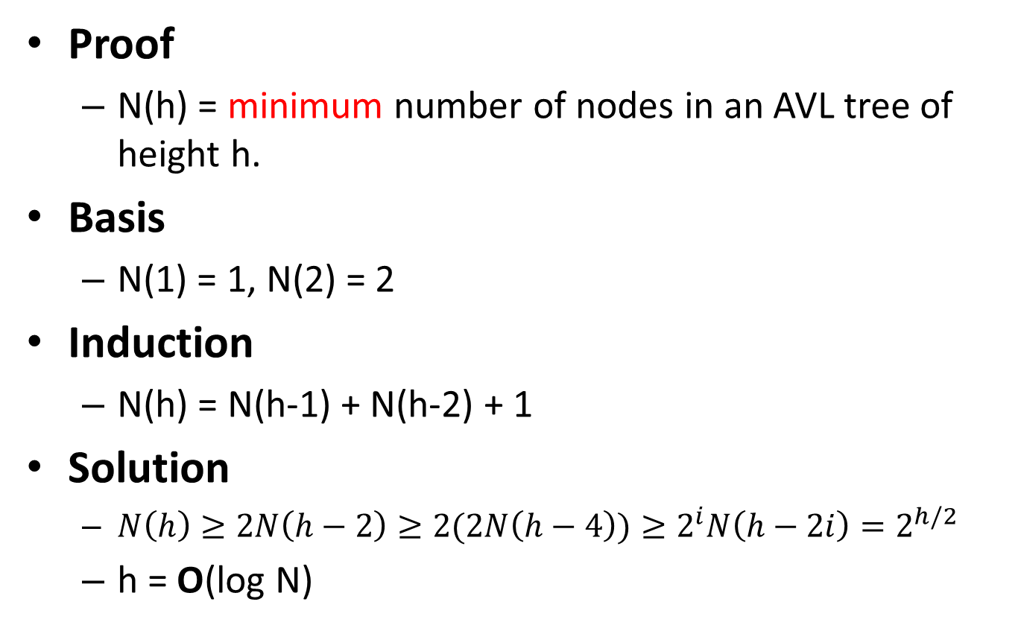
Height of an AVL Tree = O(log N)
Proof
N(h) = minimum number of nodes in an AVL tree of height h.
Basis
N(1) = 1, N(2) = 2
Induction
N(h) = N(h-1) + N(h-2) + 1
Solution
$N\left(h\right)≥2N\left(h−2\right)≥2(2N\left(h−4\right))≥2^{i}N\left(h−2i\right)=2^{h/2}$
h = O(log N)
h
h-2
h-1

Slide 10
Rebalancing
BST insertion/deletion operation may cause nodes with balance factor >1 or <–1.
Rebalancing process
Update the heights (balance factors) from the inserted/deleted node up to the root.
Fix unbalanced situations using “rotations”.
2
0
4
2
4
<3>
<2>
<2>
1
0
0
Insert 1
2
Rotation
1
4
2
<2>
<1>
<1>
<1>
1
<1>

Slide 11




Rebalancing Operation
Left / right rotation can rebalance the tree.
Right rotation
X
Y
Y
$$γ$$
$$α$$
X
$$α$$
$$β$$
$$β$$
$$γ$$
Left rotation

Slide 12
Unbalanced Situations
There are 4 kinds of imbalanced situations:
2 outside cases: require single rotation (LL, RR)
2 inside cases: require double rotation (LR, RL)
2
-2
2
-2
A
A
A
A
B
B
B
B
h
h
h
h
h
h
h
h
h+1
h+1
h+1
h+1
2 outside cases
2 inside cases

Slide 13
Rotation - Outside Cases
A
A
B
h
B
h
h
h
h+1
h+1
Right rotation
Left rotation
LL Rotation: The new node is inserted in the left subtree of the left subtree of A
RR Rotation: The new node is inserted in the right subtree of the right subtree of A

Slide 14
Rotation - Outside Cases
A
A
B
h
B
h
h
h
h+1
h+1
Right rotation
Left rotation
LL Rotation: The new node is inserted in the left subtree of the left subtree of A
RR Rotation: The new node is inserted in the right subtree of the right subtree of A

Slide 15
Rotation - Outside Cases
A
A
B
h
B
h
h
h
h+1
h+1
Right rotation
Left rotation
LL Rotation: The new node is inserted in the left subtree of the left subtree of A
RR Rotation: The new node is inserted in the right subtree of the right subtree of A

Slide 16
Rotation - Outside Cases
B
B
A
A
h+1
h
h
h
h
h+1
Height Balanced!
Height Balanced!
LL Rotation: The new node is inserted in the left subtree of the left subtree of A
RR Rotation: The new node is inserted in the right subtree of the right subtree of A

Slide 17
Rotation – Inside Cases
A
A
B
B
h
h
h
h
h+1
h+1
LR Rotation: The new node is inserted in the right subtree of the left subtree of A
RL Rotation: The new node is inserted in the left subtree of the right subtree of A

Slide 18
Rotation – Inside Cases
A
A
B
B
h
h
C
C
h
h
h
h
h
h
Left rotation
Right rotation
LR Rotation: The new node is inserted in the right subtree of the left subtree of A
RL Rotation: The new node is inserted in the left subtree of the right subtree of A

Slide 19
Rotation – Inside Cases
A
A
C
h
h
C
B
B
h
h
h
h
h
h
Left rotation
Right rotation
LR Rotation: The new node is inserted in the right subtree of the left subtree of A
RL Rotation: The new node is inserted in the left subtree of the right subtree of A

Slide 20
Rotation – Inside Cases
A
A
C
h
h
C
B
B
h
h
h
h
h
h
Left rotation + Right rotation
Right rotation + Left rotation
LR Rotation: The new node is inserted in the right subtree of the left subtree of A
RL Rotation: The new node is inserted in the left subtree of the right subtree of A

Slide 21
Rotation – Inside Cases
C
C
B
A
A
B
h
h
h
h
h
h
h
h
Left rotation + Right rotation
Right rotation + Left rotation
LR Rotation: The new node is inserted in the right subtree of the left subtree of A
RL Rotation: The new node is inserted in the left subtree of the right subtree of A

Slide 22
AVL Tree: Insert 17
To insert 17
17>12
12
<4>
17>16
6
16
<2>
<3>
17<20
4
14
20
<1>
<1>
<2>
18
17<18
<1>
17
<1>

Slide 23
AVL Tree: Insert 17
Update the heights from 17 up to the root.
12
<4>
6
16
<2>
<3>
Use rebalancing
LL rotation!
4
14
20
2
20
<1>
<1>
<3>
<2>
18
18
1
<2>
<1>
17
0
<1>

Slide 24
AVL Tree: Insert 17
Update the heights from 17 up to the root.
Finish!
-1
12
<4>
-1
6
16
<2>
<3>
4
14
18
0
<1>
<1>
<2>
17
20
<1>
<1>

Slide 25
AVL Tree: Insert 5
To insert 5
5<12
12
<4>
5<6
6
16
<2>
<3>
5>4
4
14
18
<1>
<1>
<2>
5
17
20
<1>
<1>
<1>

Slide 26
AVL Tree: Insert 5
Update the heights from 5 up to the root.
12
Use rebalancing
LR rotation!
<4>
2
6
16
<3>
<3>
-1
4
14
18
<2>
<1>
<2>
5
0
17
20
<1>
<1>
<1>

Slide 27
AVL Tree: Insert 5
Update the heights from 5 up to the root.
12
Use rebalancing
LR rotation!
<4>
2
6
16
<3>
<3>
5
14
18
<2>
<1>
<2>
4
17
20
<1>
<1>
<1>

Slide 28
AVL Tree: Insert 5
Update the heights from 5 up to the root.
Finish!
-1
12
Use rebalancing
LR rotation!
<4>
0
5
16
<2>
<3>
4
6
14
18
<1>
<1>
<1>
<2>
17
20
<1>
<1>

Slide 29
AVL Tree: Delete 16
To delete 16
16>12
12
<4>
14 replaces 16
Delete 14!
5
16
<2>
<3>
4
6
14
18
<1>
<1>
<1>
<2>
17
20
<1>
<1>

Slide 30
AVL Tree: Delete 16
Update the heights from 14 up to the root.
12
<4>
Use rebalancing
RR rotation!
14
-2
5
<3>
<2>
4
6
18
<1>
<1>
<2>
17
20
<1>
<1>

Slide 31
AVL Tree: Delete 16
Update the heights from 14 up to the root.
Finish!
-1
12
<4>
18
0
5
<3>
<2>
4
6
14
20
<1>
<1>
<2>
<1>
17
<1>

Slide 32
AVL Tree: Delete 4
To delete 4
12
<4>
5
18
<2>
<3>
4
6
14
20
<1>
<1>
<2>
<1>
17
<1>

Slide 33
AVL Tree: Delete 4
To delete 4
12
<4>
5
18
<2>
<3>
6
14
20
<1>
<2>
<1>
17
<1>

Slide 34
AVL Tree: Delete 6
To delete 6
12
<4>
5
18
<2>
<3>
6
14
20
<1>
<2>
<1>
17
<1>

Slide 35
AVL Tree: Delete 6
To delete 6
Use rebalancing
RL rotation!
12
-2
<4>
5
18
<1>
<3>
14
20
<2>
<1>
17
<1>

Slide 36
AVL Tree: Delete 6
To delete 6
Use rebalancing
RL rotation!
12
-2
<4>
5
14
<1>
<3>
18
<2>
17
20
<1>
<1>

Slide 37
AVL Tree: Delete 6
To delete 6
Finish!
14
<3>
12
18
<2>
<2>
5
17
20
<1>
<1>
<1>

Slide 38
ADT: AVL Tree
template < class T > class AVLTree;
template < class T >
Class TreeNode {
friend class AVLTree <T>;
private:
T data;
int height;
void updateHeight();
int bf();
TreeNode<T>* left, right;
};
template <class T>
Class AVLTree{
public:
// Constructor
AVLTree(void) {root=NULL;}
// Tree operations here…
private:
TreeNode<T> *root;
};

Slide 39
AVL Tree Insert/delete
template < class T >
TreeNode<T>* AVLTree<T>::insert(TreeNode<T> *node, T data)
{
// BST Insert
// ...
// rebalance from node to root
node->updateHeight();
return rebalance( node );
}
template < class T >
TreeNode<T>* AVLTree<T>::delete(TreeNode<T> *node, T data)
{
// BST Delete
// ...
// rebalance from node to root
node->updateHeight();
return rebalance( node );
}

Slide 40
AVL Tree Rebalance
template < class T >
TreeNode<T>* AVLTree<T>::rebalance(TreeNode<T> *node){
// LL Rotation
if ( node->bf()>1 && node->left->bf()>=0 ){
return rightRotate( node );
}
// RR Rotation
if ( node->bf()<-1 && node->right->bf()<=0 ){
return leftRotate( node );
}
// LR Rotation
if ( node->bf()>1 && node->left->bf()<0 ){
node->left = leftRotate( node->left );
return rightRotate( node );
}
// RL Rotation
if ( node->bf()<-1 && node->right->bf()>0 ){
node->right = rightRotate( node->right );
return leftRotate( node );
}
}

Slide 41
AVL Tree Left/Right Rotation
template < class T >
TreeNode<T>* AVLTree<T>::leftRotate(TreeNode<T> *node)
{
TreeNode<T>* node_r = node->right;
TreeNode<T>* node_rl = node_r->left;
node_r->left = node;
node->right = node_rl;
node->UpdateHeight();
node_r->UpdateHeight();
return node_r;
}
template < class T >
TreeNode<T>* AVLTree<T>::rightRotate(TreeNode<T> *node)
{
TreeNode<T>* node_l = node->left;
TreeNode<T>* node_lr = node_l->right;
node_l->right = node;
node->left = node_lr;
node->UpdateHeight();
node_l->UpdateHeight();
return node_l;
}

